Slide 1
Chapter 2: Operating-System Services

Slide 2
Outline
Operating System Services
User and Operating System-Interface
System Calls
System Services
Linkers and Loaders
Why Applications are Operating System Specific
Design and Implementation
Operating System Structure
Building and Booting an Operating System
Operating System Debugging

Slide 3
Objectives
Identify services provided by an operating system
Illustrate how system calls are used to provide operating system services
Compare and contrast monolithic, layered, microkernel, modular, and hybrid strategies for designing operating systems
Illustrate the process for booting an operating system
Apply tools for monitoring operating system performance
Design and implement kernel modules for interacting with a Linux kernel

Slide 4
Operating System Services
Operating systems provide an environment for execution of programs and services to programs and users
One set of operating-system services provides functions that are helpful to the user:
  User interface - Almost all operating systems have a user interface (UI).
    Varies between Command-Line (CLI), Graphics User Interface (GUI), touch-screen
  Program execution - The system must be able to load a program into memory and to run that program, end execution, either normally or abnormally (indicating error)
  I/O operations - A running program may require I/O, which may involve a file or an I/O device
  File-system manipulation - Programs need to read and write files and directories, create and delete them, search them, list file Information, permission management.

Slide 5
Operating System Services (Cont.)
One set of operating-system services provides functions that are helpful to the user (Cont.):
  Communications – Processes may exchange information, on the same computer or between computers over a network
    Communications may be via shared memory or through message passing (packets moved by the OS)
  Error detection – OS needs to be constantly aware of possible errors
    May occur in the CPU and memory hardware, in I/O devices, in user program
    For each type of error, OS should take the appropriate action to ensure correct and consistent computing
    Debugging facilities can greatly enhance the user’s and programmer’s abilities to efficiently use the system

Slide 6
Operating System Services (Cont.)
Another set of OS functions exists for ensuring the efficient operation of the system itself via resource sharing
  Resource allocation - When multiple users or multiple jobs running concurrently, resources must be allocated to each of them
    Many types of resources - CPU cycles, main memory, file storage, I/O devices.
  Logging - To keep track of which users use how much and what kinds of computer resources
  Protection and security - The owners of information stored in a multiuser or networked computer system may want to control use of that information, concurrent processes should not interfere with each other
    Protection involves ensuring that all access to system resources is controlled
    Security of the system from outsiders requires user authentication, extends to defending external I/O devices from invalid access attempts

Slide 7
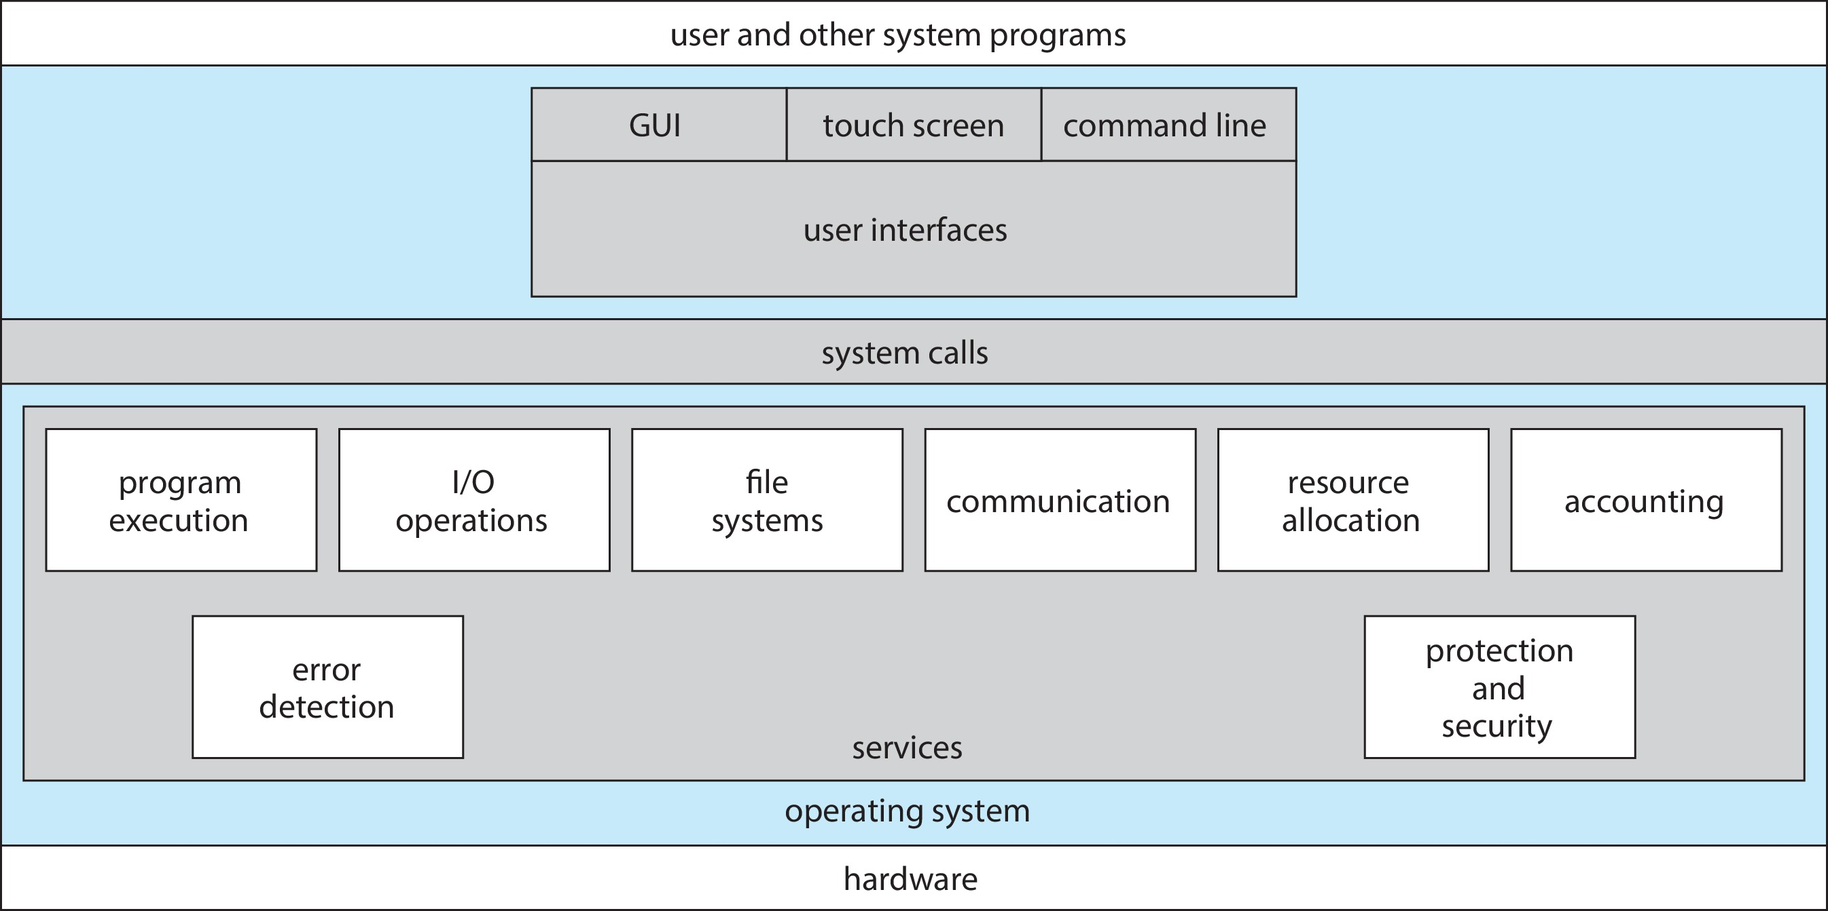
A View of Operating System Services

Slide 8
Command Line interpreter
CLI allows direct command entry
Sometimes implemented in kernel, sometimes by systems program
Sometimes multiple flavors implemented – shells
Primarily fetches a command from user and executes it
Sometimes commands built-in, sometimes just names of programs
  If the latter, adding new features doesn’t require shell modification

Slide 9
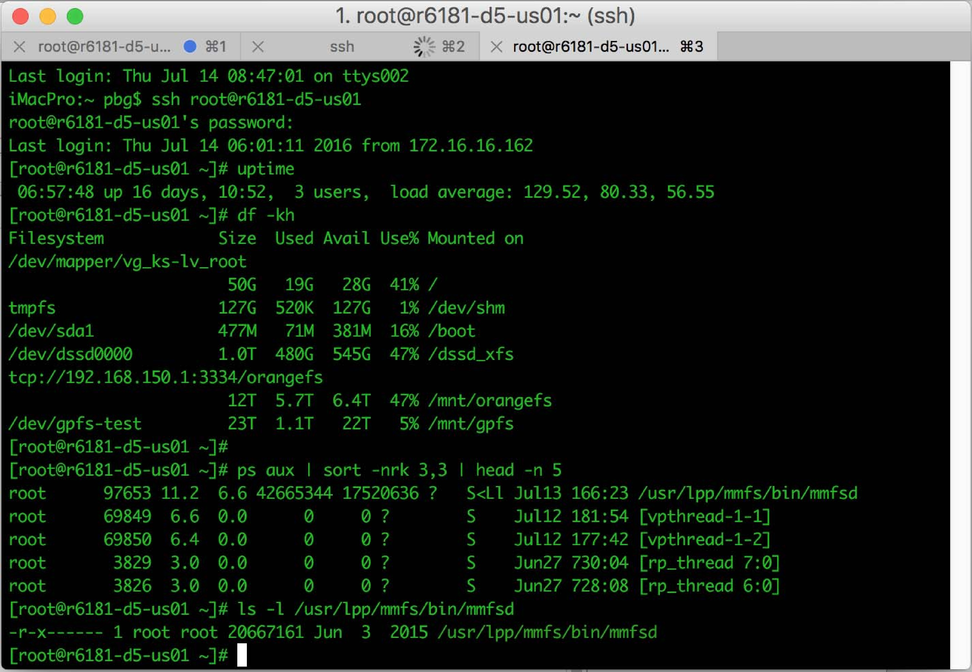
Bourne Shell Command Interpreter

Slide 10
User Operating System Interface - GUI
User-friendly desktop metaphor interface
  Usually mouse, keyboard, and monitor
  Icons represent files, programs, actions, etc
  Various mouse buttons over objects in the interface cause various actions (provide information, options, execute function, open directory (known as a folder))
Many systems now include both CLI and GUI interfaces
  Microsoft Windows is GUI with CLI “command” shell
  Apple Mac OS X is “Aqua” GUI interface with UNIX kernel underneath and shells available
  Unix and Linux have CLI with optional GUI interfaces (CDE, KDE, GNOME)

Slide 11
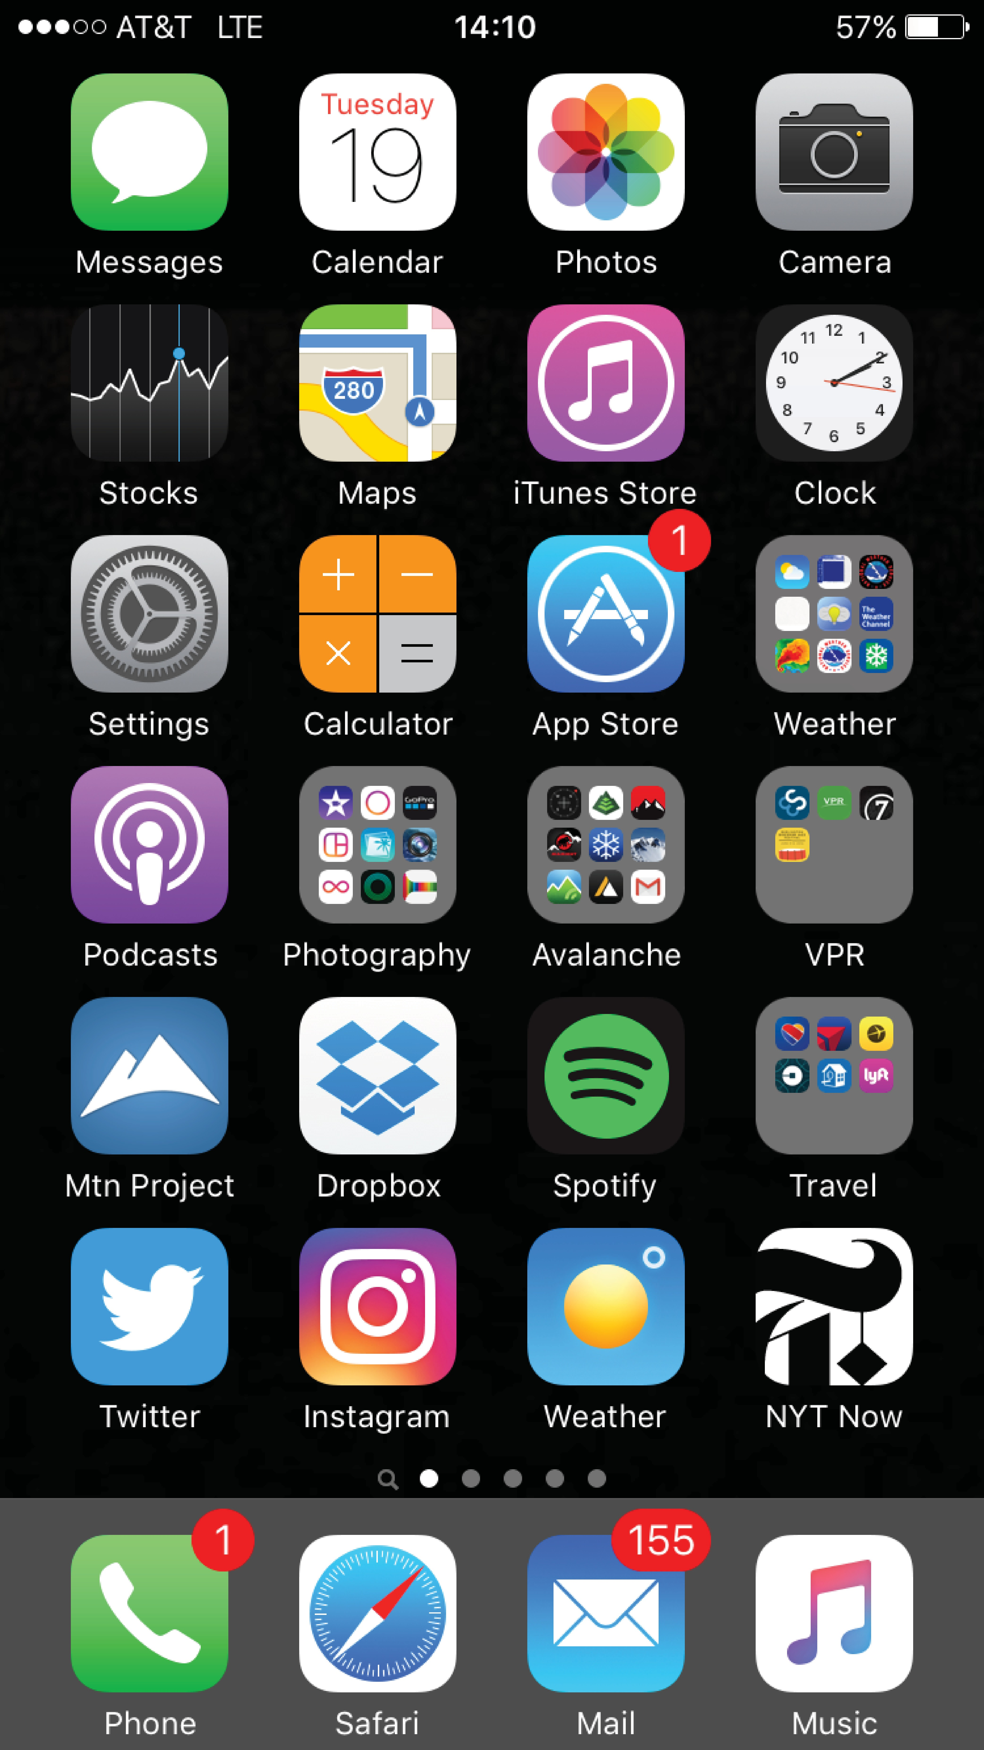
Touchscreen Interfaces
Touchscreen devices require new interfaces
  Mouse not possible or not desired
  Actions and selection based on gestures
  Virtual keyboard for text entry
Voice commands

Slide 12
System Calls
Programming interface to the services provided by the OS
Typically written in a high-level language (C or C++)
Mostly accessed by programs via a high-level Application Programming Interface (API) rather than direct system call use
Three most common APIs are Win32 API for Windows, POSIX API for POSIX-based systems (including virtually all versions of UNIX, Linux, and Mac OS X), and Java API for the Java virtual machine (JVM)
Note that the system-call names used throughout this text are generic
Notes:
POSIX (Portable Operating System Interface) is a set of standards specified by the IEEE (Institute of Electrical and Electronics Engineers) for maintaining compatibility between operating systems. It defines a standard interface and environment, including a command-line shell and utility interfaces, so that software programs can be written in a way that allows them to be ported across different operating systems without requiring significant changes.
### **Key Aspects of POSIX:**
1. **Standardization:**
- POSIX provides a standardized API (Application Programming Interface) for Unix-based operating systems. This includes system calls for tasks such as file manipulation, process management, and inter-process communication.
- The standards are designed to be compatible with Unix and Unix-like operating systems (e.g., Linux, macOS, Solaris), but they can also be implemented on non-Unix systems.
2. **Components of POSIX:**
- **POSIX.1 (IEEE 1003.1):** Defines the core services including system calls for process creation, file operations, and error handling.
- **POSIX.2 (IEEE 1003.2):** Defines the shell and utility commands like `ls`, `cp`, `grep`, etc.
- **POSIX.4:** Deals with real-time extensions, including real-time scheduling, signals, and timers.
- **POSIX Threads (Pthreads):** A standard for multi-threading which allows for the creation and management of multiple threads within a single process.
3. **Portability:**
- POSIX aims to make it easier for developers to write portable code. A program written to adhere to POSIX standards can run on any compliant operating system with minimal modifications.
- This is particularly important in environments where software needs to run on different types of systems or where it is developed on one system and deployed on another.
4. **POSIX Compliance:**
- Operating systems can be fully or partially POSIX-compliant. Full compliance means the OS supports all features and functions defined by the POSIX standard.
- Examples of POSIX-compliant systems include Linux, macOS, and Solaris. Windows provides some POSIX-compliant layers, such as the Windows Subsystem for Linux (WSL).
5. **Shell and Utilities:**
- POSIX also defines a standard shell (usually the Bourne shell or a compatible shell) and a set of command-line utilities, ensuring consistent behavior across different systems.
- These utilities include basic file manipulation commands, text processing tools, and other common command-line operations.
6. **POSIX and the C Programming Language:**
- POSIX is closely associated with the C programming language, and many POSIX APIs are designed for use in C. This is because Unix and Unix-like systems were traditionally developed in C.
7. **POSIX in Modern Systems:**
- Although originally designed for Unix systems, POSIX has influenced the design of many modern operating systems and has become a key part of many non-Unix systems through compatible layers and subsystems.
### **Applications of POSIX:**
- **Software Development:** Developers use POSIX standards to write cross-platform applications that can run on any POSIX-compliant operating system.
- **Embedded Systems:** POSIX is used in some embedded systems where a lightweight, standardized API is needed.
- **Interoperability:** Ensures that software tools, scripts, and applications behave consistently across different systems, facilitating integration and migration.
In summary, POSIX is essential for ensuring that applications can be portable across different operating systems, providing a common ground for system calls, utilities, and development environments.

Slide 13
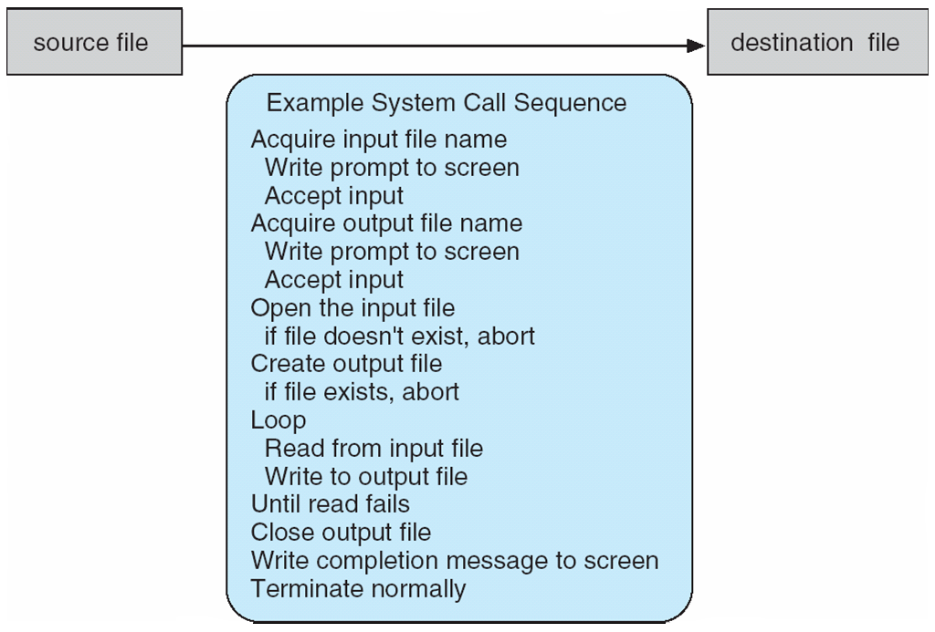
Example of System Calls
System call sequence to copy the contents of one file to another file

Slide 14
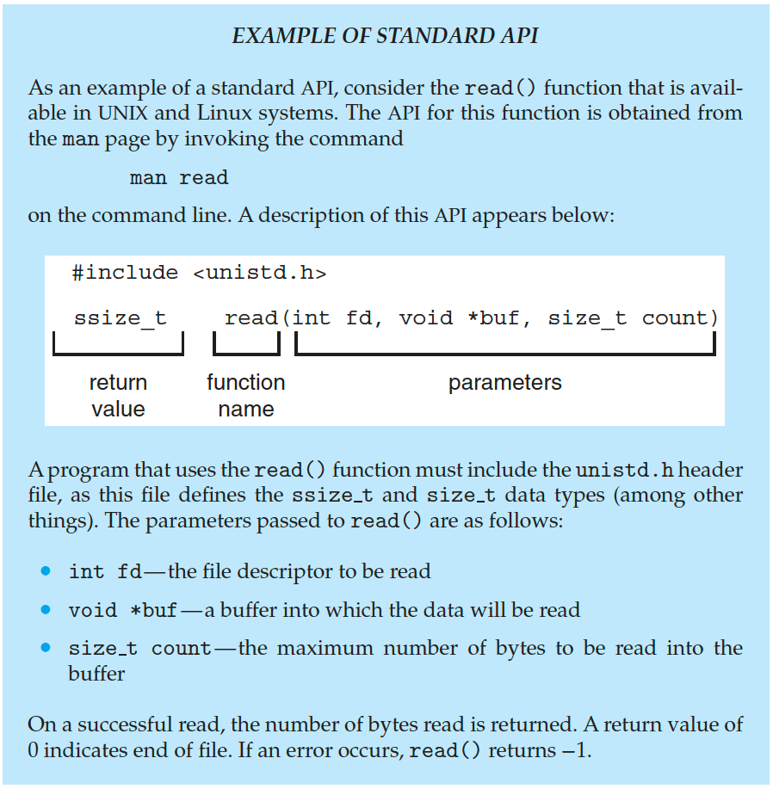
Example of Standard API

Slide 15
System Call Implementation
Typically, a number is associated with each system call
  System-call interface maintains a table indexed according to these numbers
The system call interface invokes the intended system call in OS kernel and returns status of the system call and any return values
The caller need know nothing about how the system call is implemented
  Just needs to obey API and understand what OS will do as a result call
  Most details of OS interface hidden from programmer by API

Slide 16
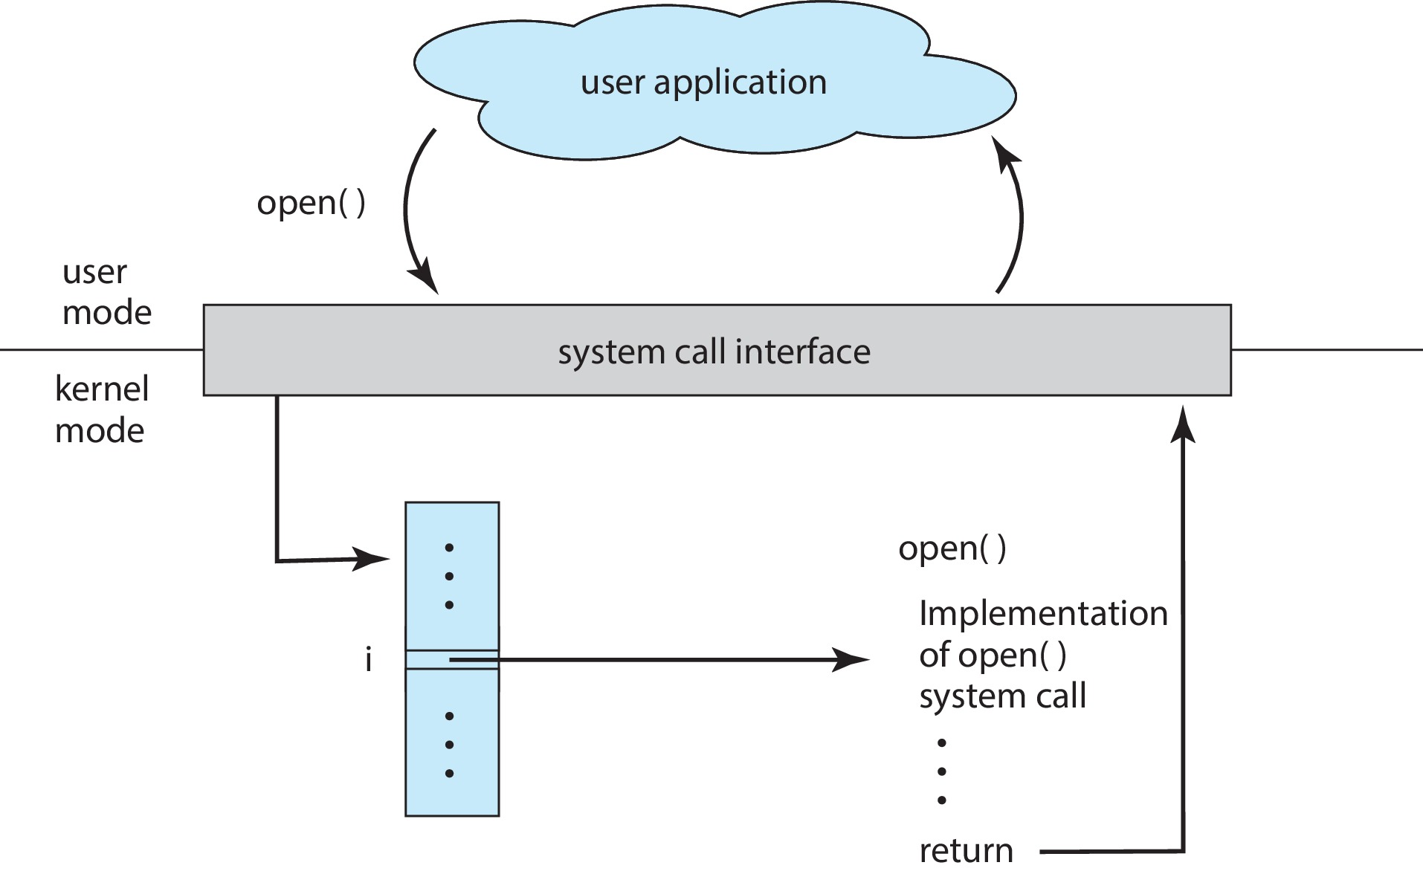
API – System Call – OS Relationship

Slide 17
System Call Parameter Passing
Often, more information is required than simply identity of desired system call
  Exact type and amount of information vary according to OS and call
Three general methods used to pass parameters to the OS
  Simplest: pass the parameters in registers
    In some cases, may be more parameters than registers
  Parameters stored in a block, or table, in memory, and address of block passed as a parameter in a register
    This approach taken by Linux and Solaris
  Parameters placed, or pushed, onto the stack by the program and popped off the stack by the operating system
  Block and stack methods do not limit the number or length of parameters being passed

Slide 18
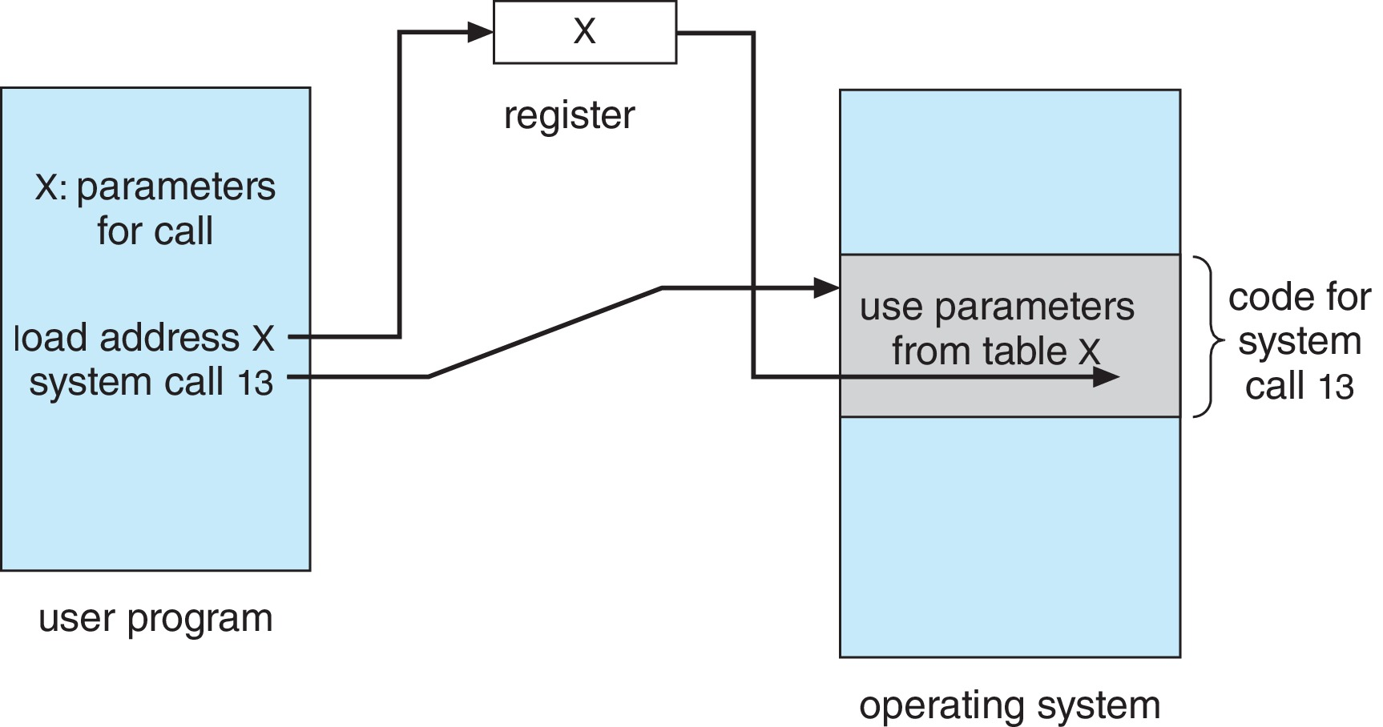
Parameter Passing via Table

Slide 19
Types of System Calls
Process control
  create process, terminate process
  end, abort
  load, execute
  get process attributes, set process attributes
  wait for time
  wait event, signal event
  allocate and free memory
  Dump memory if error
  Debugger for determining bugs
  Locks for managing access to shared data between processes

Slide 20
Types of System Calls (Cont.)
File management
  create file, delete file
  open, close file
  read, write, reposition
  get and set file attributes
Device management
  request device, release device
  read, write
  get device attributes, set device attributes
  logically attach or detach devices

Slide 21
Types of System Calls (Cont.)
Information maintenance
  get time or date, set time or date
  get system data, set system data
  get and set process, file, or device attributes
Communications
  create, delete communication connection
  send, receive messages if message passing model to host name or process name
    From client to server
  Shared-memory model create and gain access to memory regions
  transfer status information
  attach and detach remote devices

Slide 22
Types of System Calls (Cont.)
Protection
  Control access to resources
  Get and set permissions
  Allow and deny user access

Slide 23
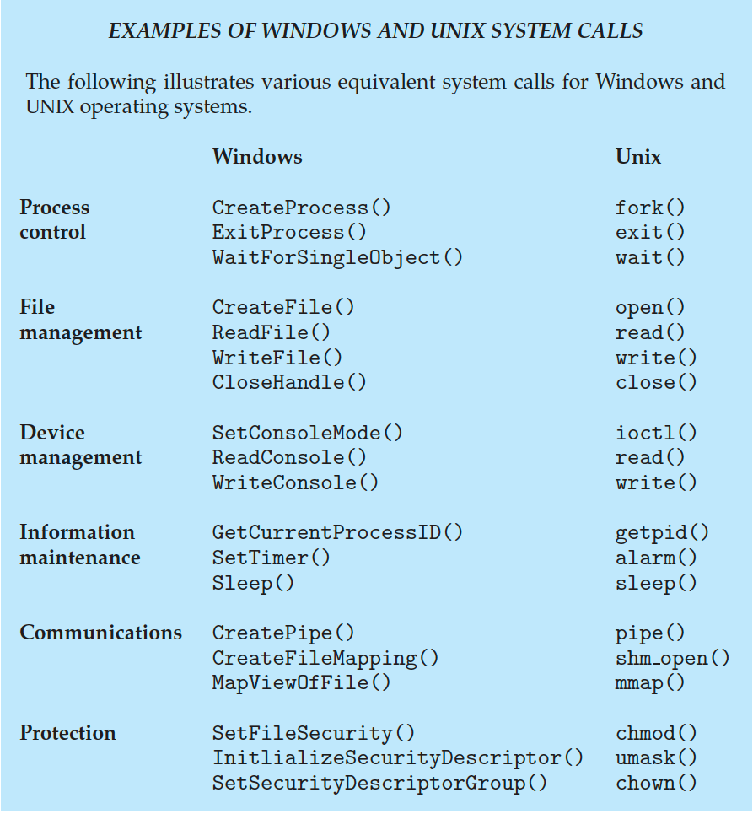
Examples of Windows and Unix System Calls

Slide 24
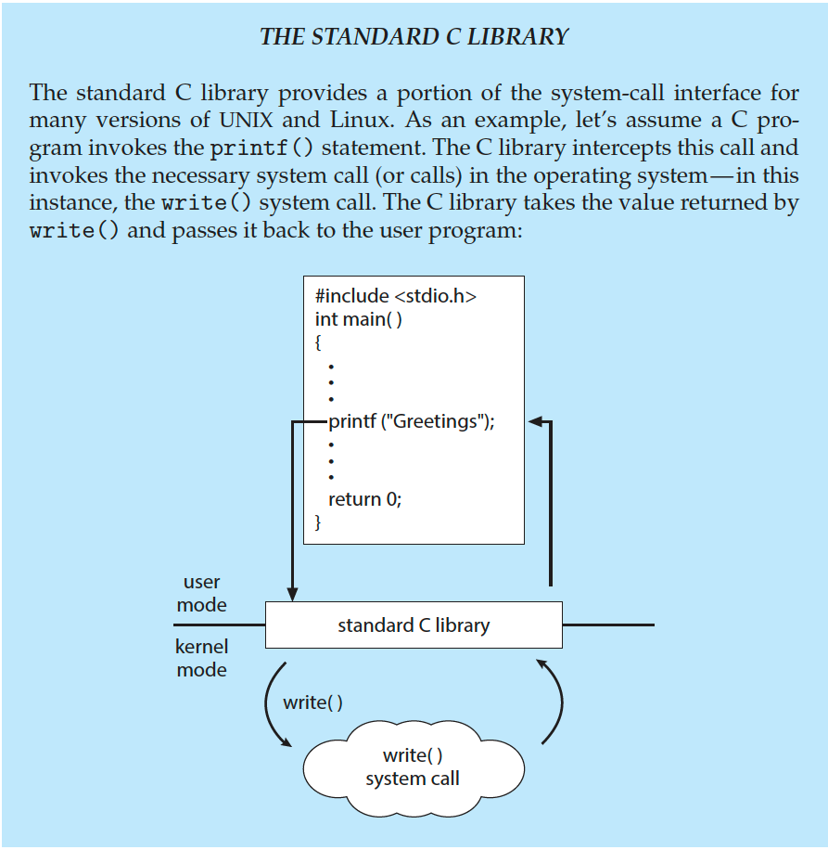
Standard C Library Example
C program invoking printf() library call, which calls write() system call

Slide 25
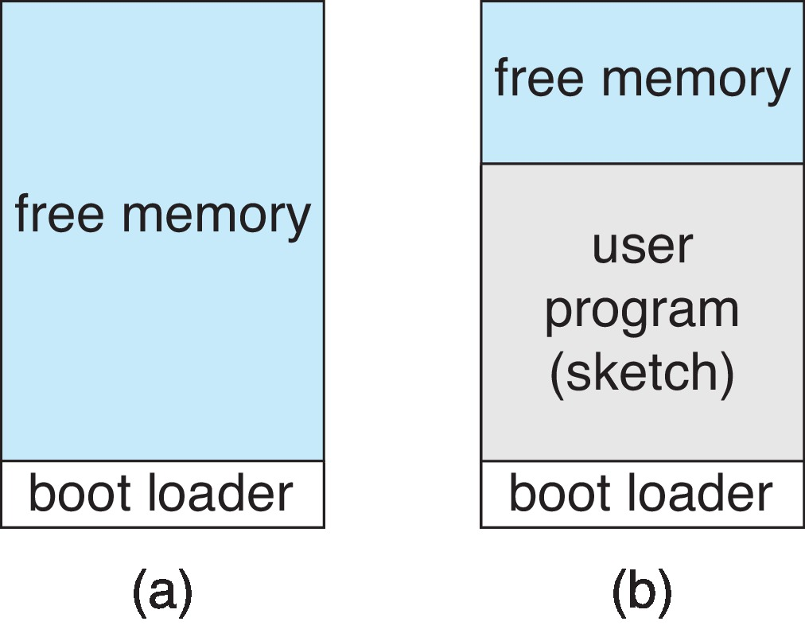
Example: Arduino
Single-tasking
No operating system
Programs (sketch) loaded via USB into flash memory
Single memory space
Boot loader loads program
Program exit -> shell reloaded
At system startup running a program

Slide 26
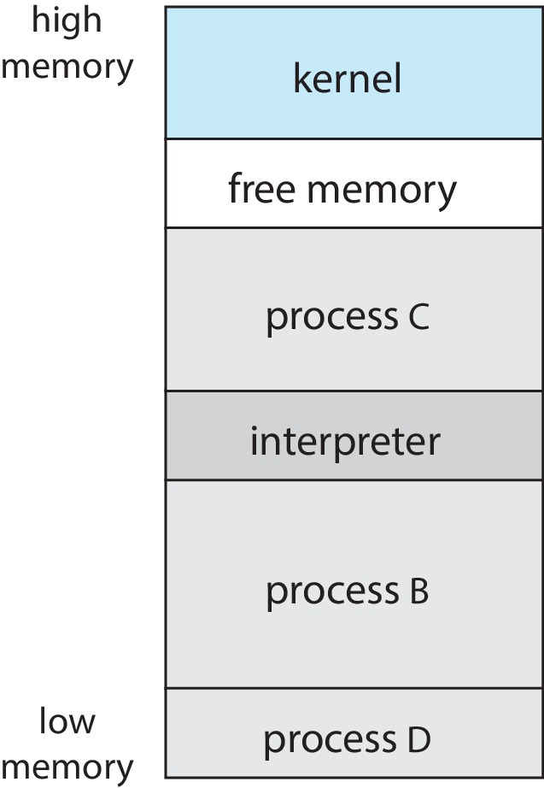
Example: FreeBSD
Unix variant
Multitasking
User login -> invoke user’s choice of shell
Shell executes fork() system call to create process
  Executes exec() to load program into process
  Shell waits for process to terminate or continues with user commands
Process exits with:
  code = 0 – no error
  code > 0 – error code

Slide 27
System Services
System programs provide a convenient environment for program development and execution. They can be divided into:
  File manipulation
  Status information sometimes stored in a file
  Programming language support
  Program loading and execution
  Communications
  Background services
  Application programs

Slide 28
System Services (Cont.)
Provide a convenient environment for program development and execution
File management - Create, delete, copy, rename, print, dump, list, and generally manipulate files and directories
Status information
  Some ask the system for info - date, time, amount of available memory, disk space, number of users
  Others provide detailed performance, logging, and debugging information
  Typically, these programs format and print the output to the terminal or other output devices
  Some systems implement a registry - used to store and retrieve configuration information

Slide 29
System Services (Cont.)
File modification
  Text editors to create and modify files
  Special commands to search the contents of files
Programming-language support - Compilers, assemblers, debuggers and interpreters sometimes provided
Program loading and execution- loaders, linkage editors, and debugging systems for higher-level and machine language
Communications - Provide the mechanism for creating virtual connections among processes, users, and computer systems
  Allow users to send messages to one another’s screens, browse web pages, send electronic-mail messages, log in remotely, transfer files from one machine to another

Slide 30
System Services (Cont.)
Background Services
  Launch at boot time
    Some for system startup, then terminate
    Some from system boot to shutdown
  Provide facilities like disk checking, process scheduling, error logging, printing
  Run in user context not kernel context
  Known as services, subsystems, daemons
Application programs
  Don’t pertain to system
  Run by users
  Not typically considered part of OS
  Launched by command line, mouse click, finger poke

Slide 31
Linkers and Loaders
Source code compiled into object files designed to be loaded into any physical memory location – relocatable object file
Linker combines these into single binary executable file
  Also brings in libraries
Program resides on secondary storage as binary executable
Must be brought into memory by loader to be executed
  Relocation assigns final addresses to program parts and adjusts code and data in program to match those addresses
Modern general purpose systems don’t link libraries into executables
  Rather, dynamically linked libraries (in Windows, DLLs) are loaded as needed, shared by all that use the same version of that same library (loaded once)
Notes:
### **Comparing DLLs vs. Relocatable Object Files**
**Dynamically Linked Libraries (DLLs)** and **Relocatable Object Files** are both integral to the software development process but serve different purposes and operate at different stages of the build and execution process. Below is a detailed comparison between the two:
---
### **1. Purpose and Usage**
- **Relocatable Object Files:**
- **Purpose:** These files are generated during the compilation process from source code and are meant to be combined (linked) into an executable or another library (such as a static library). They contain machine code, data, and metadata but are not directly executable.
- **Usage:** They are used as intermediate files that feed into the linker, which then produces a final executable or a static library. They enable modular compilation, where different parts of a program can be compiled separately and then linked together.
- **DLLs (Dynamically Linked Libraries):**
- **Purpose:** DLLs are a form of shared library that contains code, data, and resources that can be loaded and linked at runtime. They allow multiple programs to share the same code base without embedding it directly into their executables.
- **Usage:** DLLs are used during the execution phase of a program. They are loaded into memory as needed, and their functions and resources can be called by any program that links to them, reducing memory usage and enabling modular design.
---
### **2. Stage in the Development Process**
- **Relocatable Object Files:**
- **Stage:** These files are part of the compilation stage. After the compiler generates them, they are passed to the linker, which combines them into a final executable or library.
- **Role in Build Process:** They provide the flexibility to compile different modules independently and link them later, enabling faster builds and easier debugging.
- **DLLs:**
- **Stage:** DLLs come into play at runtime, not during the initial build process. The program executable references the DLL, which the operating system loads when the program runs.
- **Role in Runtime:** They allow the program to load only the necessary libraries when needed, facilitating memory management and allowing updates to the library without recompiling the entire program.
---
### **3. Linking Type**
- **Relocatable Object Files:**
- **Linking Type:** **Static Linking** (during the build process)
- **Details:** The linker takes these object files and combines them into a single executable or library. All symbols and addresses are resolved at this stage, and the final output is a standalone executable that no longer requires the object files.
- **Output:** After linking, the resulting executable contains all the necessary code and data, with no external dependencies on the original object files.
- **DLLs:**
- **Linking Type:** **Dynamic Linking** (during runtime)
- **Details:** Programs are linked to DLLs either at runtime or during loading. The executable references functions and data in the DLL, but these are only loaded when the program actually needs them, allowing for on-demand usage and efficient memory use.
- **Output:** The program relies on external DLL files at runtime, so the DLLs must be present on the system for the program to function correctly.
---
### **4. Memory and Resource Usage**
- **Relocatable Object Files:**
- **Memory Usage:** Relocatable object files themselves do not directly affect memory usage because they are intermediate files. However, when linked into an executable, all the code is included in the executable, potentially leading to larger memory footprints since everything is loaded into memory when the program runs.
- **Resource Sharing:** Object files are not shared between programs; each program has its own copy of the linked code in its executable.
- **DLLs:**
- **Memory Usage:** DLLs help reduce memory usage because the operating system loads them only once into memory, and they can be shared across multiple programs. This shared usage can significantly reduce the memory footprint when multiple programs use the same DLL.
- **Resource Sharing:** DLLs are designed to be shared. Multiple programs can use the same DLL simultaneously, reducing duplication and improving system efficiency.
---
### **5. Modularity and Flexibility**
- **Relocatable Object Files:**
- **Modularity:** Object files allow developers to work on different parts of a program independently. However, once linked into an executable, they lose their modularity since the entire program becomes a single entity.
- **Flexibility:** Less flexible after linking, as any change requires recompiling and relinking.
- **DLLs:**
- **Modularity:** DLLs are inherently modular and can be updated or replaced independently of the main program. This makes them ideal for large, modular applications where different components can be developed and maintained separately.
- **Flexibility:** Highly flexible, as DLLs can be updated, replaced, or even loaded conditionally at runtime without needing to recompile the main application.
---
### **6. Example Scenarios**
- **Relocatable Object Files:**
- **Example:** In a large C/C++ project, the `main.o` file might contain the main program logic, while `math.o` contains mathematical functions. These are linked together to form `main.exe`.
- **DLLs:**
- **Example:** A Windows application might use `user32.dll` for user interface functions, `gdi32.dll` for graphics, and a custom `myplugin.dll` for application-specific features. These DLLs are loaded as needed, and multiple applications might use `user32.dll` simultaneously.
---
### **7. Updating and Maintenance**
- **Relocatable Object Files:**
- **Updating:** Once the final executable is built, updating the program requires recompiling and relinking. The object files themselves are not part of the final product delivered to users.
- **Maintenance:** Changes to the code require recompiling the affected modules and relinking, which can be time-consuming in large projects.
- **DLLs:**
- **Updating:** A DLL can be updated independently of the main application. As long as the interface (e.g., function signatures) remains consistent, the application can use the new DLL without modification.
- **Maintenance:** Easier to maintain and update. Bug fixes or new features can be delivered by simply replacing the DLL, without needing to rebuild the entire application.
---
### **Summary**
**Relocatable Object Files** are essential for the build process, allowing code to be compiled into machine-readable formats that can later be linked into a complete executable or library. They support modular development during the compilation stage but are not used at runtime.
**DLLs**, on the other hand, are runtime components that provide dynamic linking, memory efficiency, and modularity. They allow multiple programs to share the same library code, reducing memory usage and enabling easy updates and maintenance.
Both concepts are crucial in modern software development but serve different purposes at different stages of the software lifecycle.

Slide 32
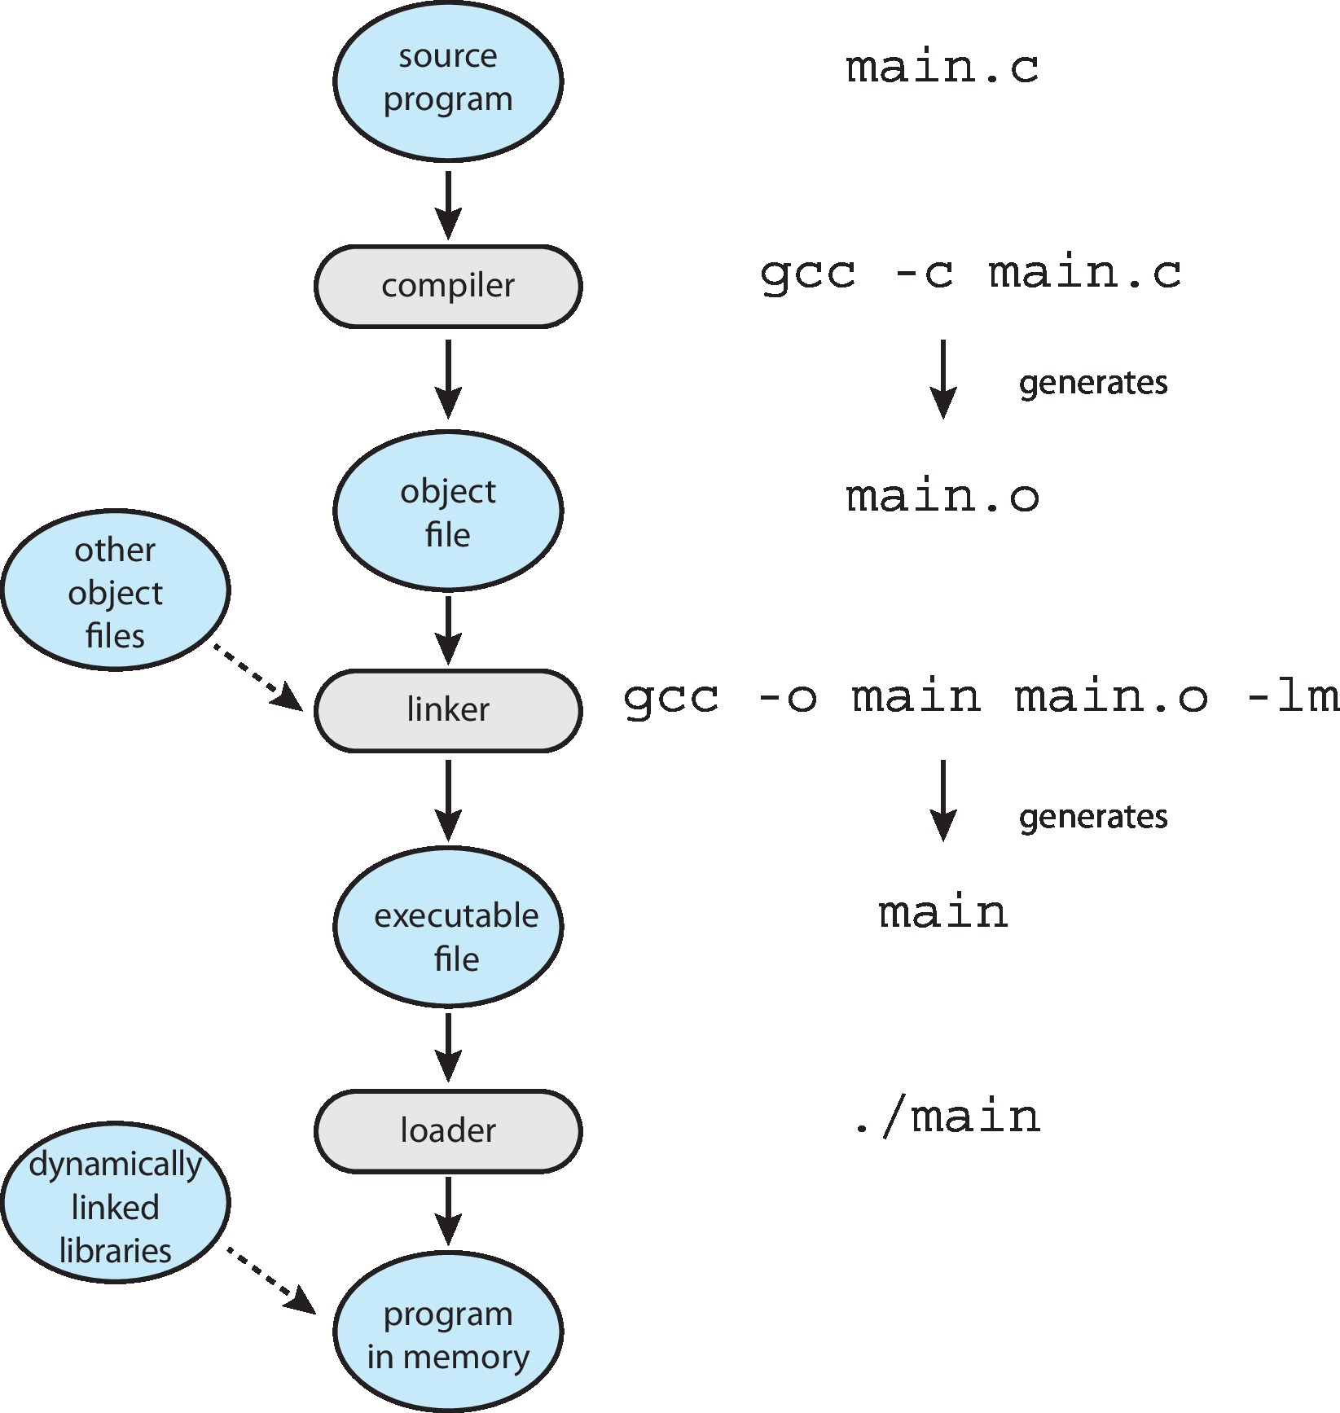
The Role of the Linker and Loader

Slide 33
Why Applications are Operating System Specific
Apps compiled on one system usually not executable on other operating systems
Each operating system provides its own unique system calls
  Own file formats, etc.
Apps can be multi-operating system
  Written in interpreted language like Python, Ruby, and interpreter available on multiple operating systems
  App written in language that includes a VM containing the running app (like Java)
Application Binary Interface (ABI) is architecture equivalent of API, defines how different components of binary code can interface for a given operating system on a given architecture, CPU, etc.

Slide 34
Design and Implementation
Design and Implementation of OS is not “solvable”, but some approaches have proven successful
Internal structure of different Operating Systems can vary widely
Start the design by defining goals and specifications
Affected by choice of hardware, type of system
User goals and System goals
  User goals – operating system should be convenient to use, easy to learn, reliable, safe, and fast
  System goals – operating system should be easy to design, implement, and maintain, as well as flexible, reliable, error-free, and efficient
Specifying and designing an OS is highly creative task of software engineering

Slide 35
Policy and Mechanism
Policy: What needs to be done?
  Example: Interrupt after every 100 seconds
Mechanism: How to do something?
  Example: timer
Important principle: separate policy from mechanism
The separation of policy from mechanism is a very important principle, it allows maximum flexibility if policy decisions are to be changed later.
  Example: change 100 to 200

Slide 36
Implementation
Much variation
  Early OSes in assembly language
  Then system programming languages like Algol, PL/1
  Now C, C++
Actually usually a mix of languages
  Lowest levels in assembly
  Main body in C
  Systems programs in C, C++, scripting languages like PERL, Python, shell scripts
More high-level language easier to port to other hardware
  But slower
Emulation can allow an OS to run on non-native hardware

Slide 37
Operating System Structure
General-purpose OS is very large program
Various ways to structure ones
  Simple structure – MS-DOS
  More complex – UNIX
  Layered – an abstraction
  Microkernel – Mach

Slide 38
Monolithic Structure – Original UNIX
UNIX – limited by hardware functionality, the original UNIX operating system had limited structuring.
The UNIX OS consists of two separable parts
  Systems programs
  The kernel
    Consists of everything below the system-call interface and above the physical hardware
    Provides the file system, CPU scheduling, memory management, and other operating-system functions; a large number of functions for one level

Slide 39
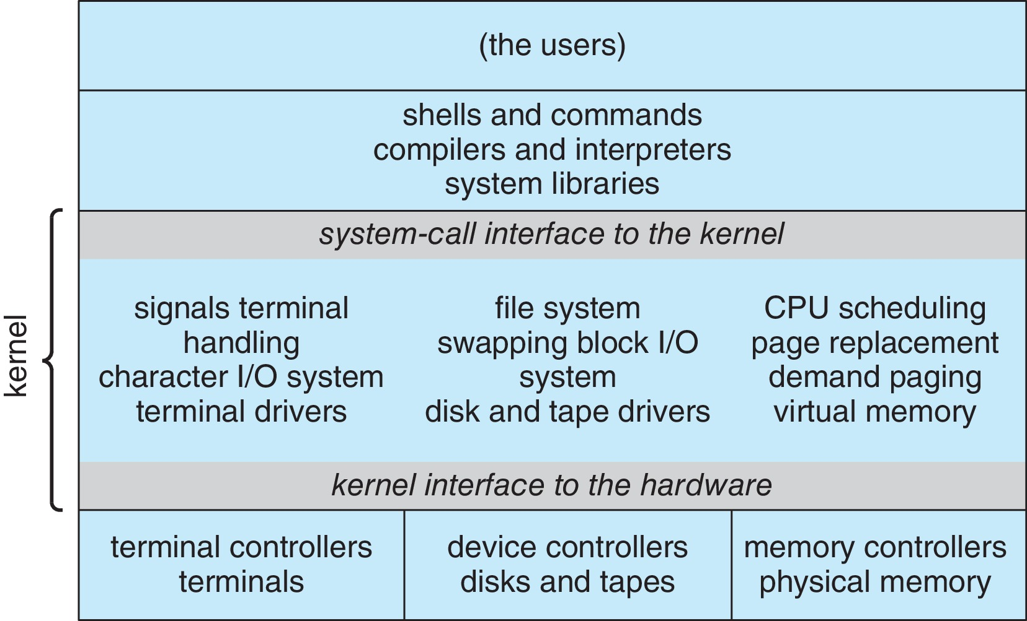
Traditional UNIX System Structure
Beyond simple but not fully layered

Slide 40
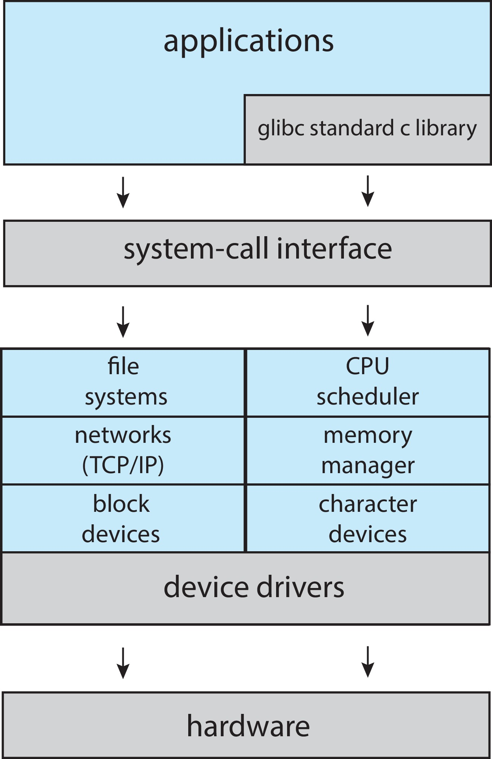
Linux System Structure
Monolithic plus modular design

Slide 41
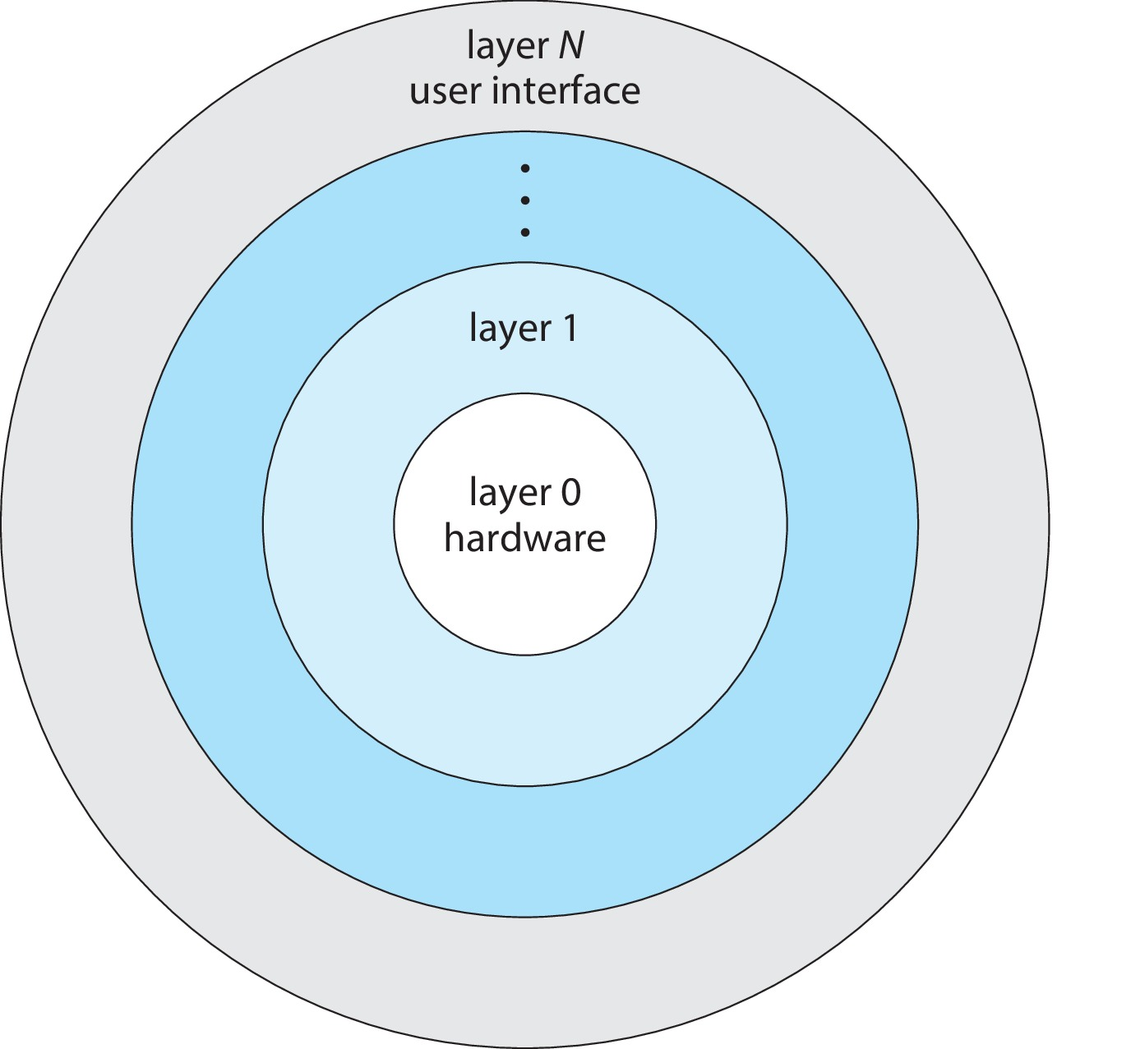
Layered Approach
The operating system is divided into a number of layers (levels), each built on top of lower layers. The bottom layer (layer 0), is the hardware; the highest (layer N) is the user interface.
With modularity, layers are selected such that each uses functions (operations) and services of only lower-level layers

Slide 42
Microkernels
Moves as much from the kernel into user space
Mach is an example of microkernel
  Mac OS X kernel (Darwin) partly based on Mach
Communication takes place between user modules using message passing
Benefits:
  Easier to extend a microkernel
  Easier to port the operating system to new architectures
  More reliable (less code is running in kernel mode)
  More secure
Detriments:
  Performance overhead of user space to kernel space communication

Slide 43
Microkernel System Structure

Slide 44
Modules
Many modern operating systems implement loadable kernel modules (LKMs)
  Uses object-oriented approach
  Each core component is separate
  Each talks to the others over known interfaces
  Each is loadable as needed within the kernel
Overall, similar to layers but with more flexible
  Linux, Solaris, etc.

Slide 45
Hybrid Systems
Most modern operating systems are not one pure model
  Hybrid combines multiple approaches to address performance, security, usability needs
  Linux and Solaris kernels in kernel address space, so monolithic, plus modular for dynamic loading of functionality
  Windows mostly monolithic, plus microkernel for different subsystem personalities
Apple Mac OS X hybrid, layered, Aqua UI plus Cocoa programming environment
  Below is kernel consisting of Mach microkernel and BSD Unix parts, plus I/O kit and dynamically loadable modules (called kernel extensions)

Slide 46
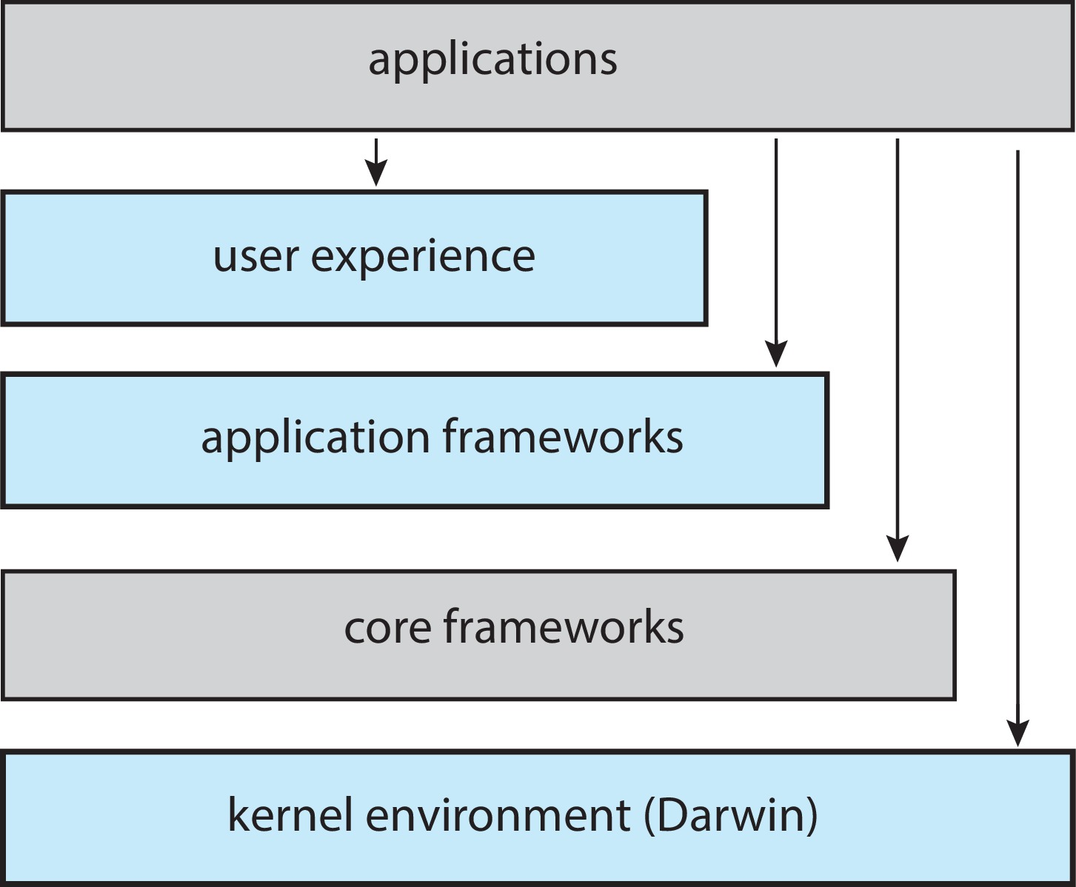
macOS and iOS Structure

Slide 47
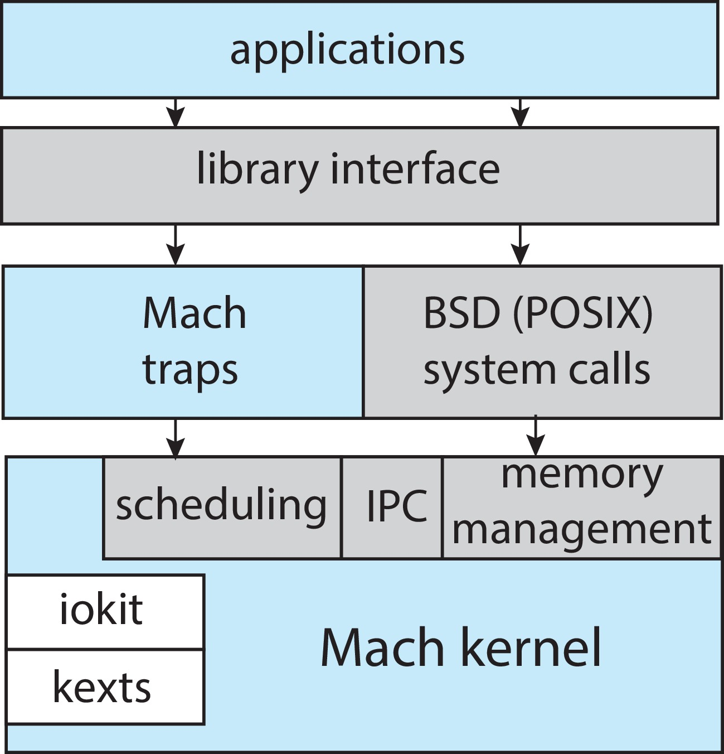
Darwin

Slide 48
iOS
Apple mobile OS for iPhone, iPad
  Structured on Mac OS X, added functionality
  Does not run OS X applications natively
    Also runs on different CPU architecture (ARM vs. Intel)
  Cocoa Touch Objective-C API for developing apps
  Media services layer for graphics, audio, video
  Core services provides cloud computing, databases
  Core operating system, based on Mac OS X kernel

Slide 49
Android
Developed by Open Handset Alliance (mostly Google)
  Open Source
Similar stack to iOS
Based on Linux kernel but modified
  Provides process, memory, device-driver management
  Adds power management
Runtime environment includes core set of libraries and Dalvik virtual machine
  Apps developed in Java plus Android API
    Java class files compiled to Java bytecode then translated to executable thnn runs in Dalvik VM
Libraries include frameworks for web browser (webkit), database (SQLite), multimedia, smaller libc

Slide 50
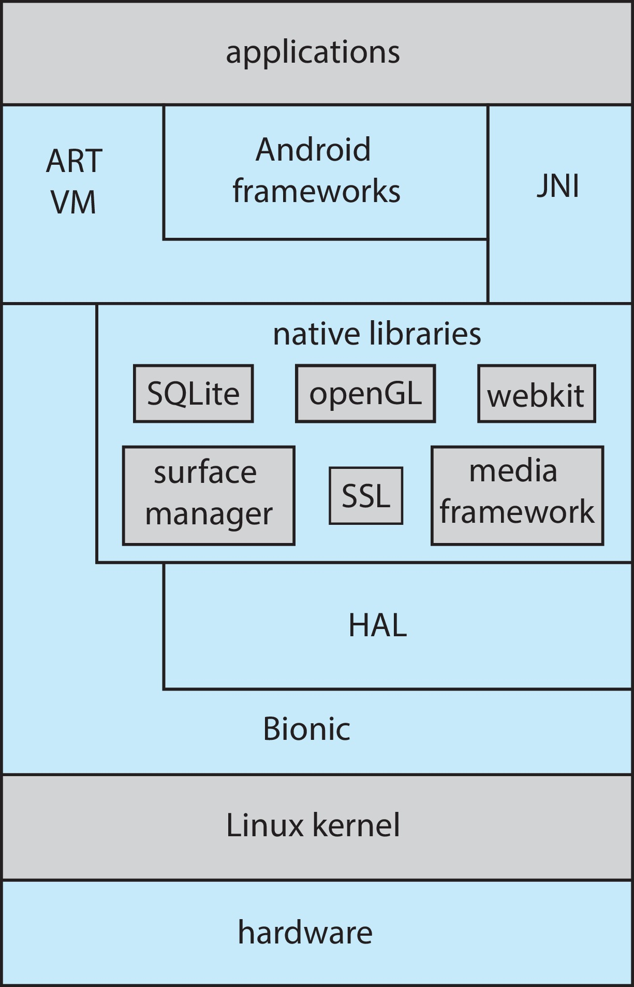
Android Architecture

Slide 51
Building and Booting an Operating System
Operating systems generally designed to run on a class of systems with variety of peripherals
Commonly, operating system already installed on purchased computer
  But can build and install some other operating systems
  If generating an operating system from scratch
    Write the operating system source code
    Configure the operating system for the system on which it will run
    Compile the operating system
    Install the operating system
    Boot the computer and its new operating system

Slide 52
Building and Booting Linux
Download Linux source code (http://www.kernel.org)
Configure kernel via “make menuconfig”
Compile the kernel using “make”
  Produces vmlinuz, the kernel image
  Compile kernel modules via “make modules”
  Install kernel modules into vmlinuz via “make modules_install”
  Install new kernel on the system via “make install”

Slide 53
System Boot
When power initialized on system, execution starts at a fixed memory location
Operating system must be made available to hardware so hardware can start it
  Small piece of code – bootstrap loader, BIOS, stored in ROM or EEPROM locates the kernel, loads it into memory, and starts it
  Sometimes two-step process where boot block at fixed location loaded by ROM code, which loads bootstrap loader from disk
  Modern systems replace BIOS with Unified Extensible Firmware Interface (UEFI)
Common bootstrap loader, GRUB, allows selection of kernel from multiple disks, versions, kernel options
Kernel loads and system is then running
Boot loaders frequently allow various boot states, such as single user mode

Slide 54
Operating-System Debugging
Debugging is finding and fixing errors, or bugs
Also performance tuning
OS generate log files containing error information
Failure of an application can generate core dump file capturing memory of the process
Operating system failure can generate crash dump file containing kernel memory
Beyond crashes, performance tuning can optimize system performance
  Sometimes using trace listings of activities, recorded for analysis
  Profiling is periodic sampling of instruction pointer to look for statistical trends
Kernighan’s Law: “Debugging is twice as hard as writing the code in the first place. Therefore, if you write the code as cleverly as possible, you are, by definition, not smart enough to debug it.”

Slide 55
Performance Tuning
Improve performance by removing bottlenecks
OS must provide means of computing and displaying measures of system behavior
For example, “top” program or Windows Task Manager

Slide 56
Tracing
Collects data for a specific event, such as steps involved in a system call invocation
Tools include
  strace – trace system calls invoked by a process
  gdb – source-level debugger
  perf – collection of Linux performance tools
  tcpdump – collects network packets

Slide 57
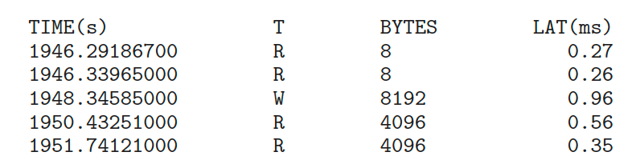
BCC
Debugging interactions between user-level and kernel code nearly impossible without toolset that understands both and an instrument their actions
BCC (BPF Compiler Collection) is a rich toolkit providing tracing features for Linux
  See also the original DTrace
For example, disksnoop.py traces disk I/O activity
Many other tools (next slide)

Slide 58
End of Chapter 2

